Slide 1
IFT222
Computer Architecture and Organization
MODULE5: IMPROVING PROCESSOR PERFORMANCE THROUGH PIPELINING

Slide 2
Improving System Performance through Pipelining

Slide 3
General Introduction
In modern computer systems, users expect programs to execute quickly and efficiently.
One of the major goals of Computer Architecture is to improve the speed and overall performance of a computer system without excessively increasing hardware cost.
One effective technique used to achieve this goal is pipelining.
Pipelining is a performance enhancement technique in which multiple instructions are processed simultaneously by dividing instruction execution into several stages.

Slide 4
General Introduction -2
Instead of waiting for one instruction to complete entirely before starting another, the processor overlaps the execution of multiple instructions.
This approach is similar to an assembly line in a factory where different stages of production occur at the same time.
A typical instruction pipeline consists of stages such as:
  Instruction Fetch (IF) – retrieving the instruction from memory
  Instruction Decode (ID) – interpreting the instruction
  Execute (EX) – performing the decoded operation
  Memory Access (MEM) – accessing memory if required
  Write Back (WB) – storing the result back into a register

Slide 5
General Introduction - 3
By allowing different instructions to occupy different stages simultaneously, pipelining increases the throughput of the processor, enabling more instructions to be completed in less time.
Although pipelining significantly improves system performance, it also introduces challenges such as pipeline hazards, data dependencies, branch instructions, and resource conflicts.
Computer architects therefore design techniques such as forwarding, stalling, and branch prediction to reduce these problems and maintain efficient execution.

Slide 6
General Introduction - 4
Pipelining is widely used in modern processors, including those developed by Intel and AMD, because it improves CPU utilization, enhances instruction throughput, and contributes to faster system performance.

Slide 7
Learning Outcomes
At the end of this topic, students should be able to:
Define pipelining and explain its role in improving computer system performance.
Describe the stages involved in a typical instruction pipeline.
Explain how pipelining increases instruction throughput and CPU efficiency.
Differentiate between non-pipelined and pipelined processor execution.
Analyze the advantages of pipelining in modern computer systems.
Identify and explain different types of pipeline hazards, including:
  Structural hazards, Data hazards and Control hazards

Slide 8
Learning Outcomes
Discuss techniques used to handle pipeline hazards, such as:
  Pipeline stalling
  Data forwarding
  Branch prediction
Calculate pipeline performance metrics such as:
  Speedup
  Throughput
  Pipeline efficiency
Evaluate the impact of pipelining on processor design and system performance.
Apply pipelining concepts to solve numerical and analytical problems in computer architecture.

Slide 9
Pipelining

Slide 10
Pipelining - Introduction
In a typical system speedup is achieved through parallelism at all levels:
Multi-user, multitasking, multi-processing, multi-programming, multi-threading, compiler optimizations.
Pipelining : is a technique for overlapping operations during
execution.
Today this is a key feature that makes fast CPUs.
Different types of pipeline: instruction pipeline, operation pipeline, multi-issue pipelines.

Slide 11
What is Pipelining? - 1
Pipeline processing is an implementation technique where arithmetic sub-operations or the phases of a computer instruction cycle overlap in execution
Pipelining exploits parallelism among instructions by overlapping them - called Instruction Level Parallelism (ILP)
Pipelining is a technique of decomposing a sequential process into sub-operations, with each sub-process being executed in a special dedicated segment that operates concurrently with all other segments
11

Slide 12
What is a Pipeline? - 2
Pipeline is like an automobile assembly line.
A pipeline has many steps or stages or segments.
Each stage carries out a different part of an instruction or operation.
The stages are connected to form a pipe.
An instruction or operation enters through one end and progresses through the stages to exit at the other end.
12

Slide 13
Pipeline Characteristics
Throughput: Number of items (cars, instructions, operations) that exit the pipeline per unit time. Ex: 1 inst /clock cycle, 10 cars/ hour, 10 floating point operations /cycle.
Stage time: The pipeline designer’s goal is to balance the
length of each pipeline stage(balanced pipeline).
In general, Stage time = Time per instruction on non-pipelined machine/ number of stages
In many instances, stage time = max (times for all stages).
CPI: Pipeline yields a reduction in cycles per instruction
CPI is approximately = stage time.
13

Slide 14
Pipeline Analogy – The Laundry
Ann, Brian, Cathy, Dave each have one load of clothes to wash, dry, stash, and fold
Washer takes 30 minutes
A B C D
Ann’s clothes
30 mins x 4 = 120 mins)
Brian
30mins x 4 = 120mins
Cathy
30mins x 4 = 120mins
480mins
Dryer takes 30 minutes
“Folder” takes 30 minutes
“Stasher” takes 30 minutes to put clothes into drawers
14

Slide 15
Pipeline Analogy – The Laundry - Sequential Operation
6 PM 7 8 12 1
2 AM
9
10 11
Ann’s clothes
30 mins x 4 = 120 mins)
Brian
30mins x 4 = 120mins
Cathy
30mins x 4 = 120mins
Dave clothes
30mins x 4 = 120mins
480mins = 8 hours
30 30 30 30 30 30 30 30 30 30 30 30 30 30 30 30
Time
A
B C D
Time Required: 8 hours for 4 loads
15

Slide 16

Pipeline Analogy – The Laundry - Overlapping Tasks
6 PM 7 8
9
10
11
12
1
2 AM
Time
Ann - 30mins = wash
Ann – 30min = dry
Brian - = wash
Ann – 30mins = stash
Brian ------ = dry
Cathy ------- = wash
Ann 30mins= fold
Brian ---------- = stash
Cathy ---------- = Dry
Dave ----------- = wash
30 30 30 30 30 30 30
A B C D
Time Required: 3.5 Hours for 4 Loads
Normal operation = 8hours
Speedup = 8/3.5 = 2.1
16

Slide 17
Pipeline Analogy – The Laundry (cont’d)
Pipelining doesn’t help latency of single task, it helps throughput of entire workload
Pipeline rate is limited by slowest pipeline stage
Multiple tasks operating simultaneously
Potential speedup = Number of pipe stages as number of tasks increases
Unbalanced lengths of pipe stages reduces speedup
Time to “fill” pipeline and time to “drain” it reduces speedup

Slide 18
Pipeline Analogy – The Laundry (cont’d)
Key idea: break big computation up into pieces
1 nanosecond = 10^-9 second
1 picosecond = 10^-12 second
1ns
Separate each piece with a pipeline register
200ps
200ps
200ps
200ps
200ps
Pipeline Register
18

Slide 19
Pipelining Analogy – Grading of Exam
Grading the Final exam for a class of 100 students:
  5 problems, five people grading the exam
  Each person ONLY grades one problem
  Pass the exam to the next person as soon as one finishes his part
  Assume each problem takes 12 min to grade
    Each individual exam still takes 1 hour to grade
    But with 5 people, all exams can be graded five times quicker
19

Slide 20
Pipelining Analogy – Grading of Exam
The load instruction has 5 stages:
  Five independent functional units to work on each stage
‒ Each functional unit is used only once
  The 2nd load can start as soon as the 1st finishes its fetch stage
  Each load still takes five cycles to complete
  The throughput, however, is much higher
20

Slide 21
Pipelining Analogy – Grading of Exam
buffer
Input Tasks
Stage 1 Stage 2 K – stage pipeline Stage k
Let n be number of tasks or exams (or instructions)
Let k be number of stages for each task
Let T be the time per stage
Time per task = T . k
Total Time per n tasks for non-pipelined solution = T . k . n
Total Time per n tasks for pipelined solution = T . k + T . (n-1)
Speedup = pipelined perform/non-pipelined performance
= Total Time non-pipelined/ Total Time for pipelined
= k . n / k + n-1 = k approx. when n >> k
21

Slide 22
Single-Cycle vs Pipelined Execution
Non-Pipelined
Instruction Order
0
200
400
600
800 1000 1200 1400 1600 1800
Time
lw | $1, | 100($0)
lw | $2, | 200($0)
lw | $3, | 300($0)
Instruction Fetch | REG RD | ALU | MEM | REG WR
800ps |  |  |  |  | Instruction Fetch | REG RD | ALU | MEM | REG WR
 |  |  |  |  |  |  |  |  |  | Instruction Fetch
800ps
800ps
Pipelined
Instruction Order
0
200
400
600
800 1000 1200 1400 1600
Time
lw | $1, | 100($0)
lw | $2, | 200($0)
lw | $3, | 300($0)
Instruction Fetch |  | REG RD | ALU |  | MEM |  | REG WR
200ps | Instruction Fetch |  |  | REG RD | ALU |  | MEM |  | REG WR
 |  |  | Instruction Fetch |  |  | REG RD | ALU |  | MEM |  | REG WR
200ps
200ps
200ps
200ps
200ps
200ps
22

Slide 23
Performance Issues in Pipelining
Speedup : How much speed up performance we get through pipelining.
  n: Number of tasks to be performed
Conventional Machine (Non-pipelined)
t_{n}:
t₁:
Clock cycle
Time required to complete n tasks
t₁ = n * t_{n}
23

Slide 24
Performance Issues in Pipelining – cont’d
Pipelined Machine (k stages)
  t_{p}: Clock cycle (time to complete each sub operation)
  t_{k}: Time required to complete the n tasks
  t_{k} = (k + (n - 1)) * t_{p}
Speedup
  S_{k}: Speedup
▪
S_{k} = n*t_{n} / (k + (n – 1))*t_{p}
24

Slide 25
Performance Issue - Example
Example
4-stage pipeline
sub operation in each stage; t_{p} = 20ns
100 tasks to be executed
1 task in non-pipelined system; 20*4 = 80ns
Pipelined System
(k + (n – 1))*t_{p} = (4 + 99) * 20 = 2060ns
Non-Pipelined System
n*t_{p} = 100 * 80 = 8000ns
Speedup
S_{k} = 8000 / 2060 = 3.88
4-Stage Pipeline is basically identical to the system with 4 identical function units
25

Slide 26
Performance Issue – Example (cont’d)
I _{i}
^{I}i+1
^{I} i+2
^{I} i+3
Multiple Functional Units
P₁
P₂
P₃
P₄
26

Slide 27
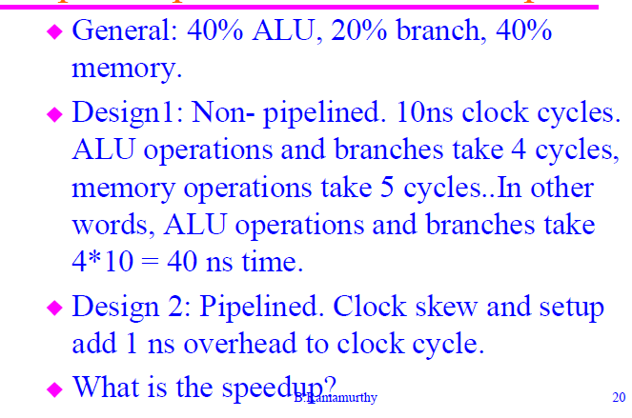
Pipeline Performance – Example2
27

Slide 28
Pipeline Performance – Example2
Design1:
Average instruction execution time = clock cycletime *CPI
• = 10ns * (4 *0.4 + 4 *0.2+ 5*0.4) = 10 *(1.6+0.8+2.0)
• = 44ns
Design 2:
Average instruction time at steady state is clock cycle time:
• = 10ns + 1ns (for setup and clock skew) = 11ns
Speed up = 44/11 = 4
28

Slide 29
Pipeline Performance – Example 3
Assume times for each functional unit of a pipeline to be: 10ns, 8ns, 10ns, 10ns and 7ns.
Overhead 1ns per stage. Compute the speed of the data path.
Pipelined: Stage time = MAX(10,8,10,10,7) + overhead
• = 10 + 1 = 11ns.
This is the average instruction execution time at steady state.
Non-pipelined: 10+8+10+10+7 = 45ns
Speedup = 45/11= 4.1 times

Slide 30
Performance Issue – (cont’d)
Efficiency: The efficiency of a pipeline can be measured as the ratio of busy time span to the total time span including the idle time.
Let c be the clock period of the pipeline, the efficiency E can be denoted as:
E = (n. m. c) / m. [m. c + (n-1).c] = n / [(m + (n-1)]
As n-> ∞ , E becomes 1.

Slide 31
Performance Issue – (cont’d)
Throughput: Throughput of a pipeline can be defined as the number of results that have been achieved per unit time.
It can be denoted as:
  T = (n / [m + (n-1)]) / c = E / c
Throughput denotes the computing power of the pipeline.
Maximum speedup, efficiency and throughput are the ideal cases.

Slide 32
Pipeline Hazards/Limitations
Hazards reduce the performance from the ideal speedup gained by pipelines:
Structural hazard: Resource conflict.
Hardware cannot support all possible combinations of instructions in simultaneous overlapped execution.
Data hazard:
When an instruction depends on the results of the previous instruction.
Control hazard:
Due to branches and other instructions that affect the PC.

Slide 33
Pipeline Stalls
A stall is the delay in cycles caused due to any of the hazards mentioned above.
Speedup :
1/(1+pipeline stall per instruction)* Number of stages
Number of cycles needed to initially fill up the pipeline could be included in computation of average stall per instruction

Slide 34
Structural Hazards
When more than one instruction in the pipeline needs to access a resource, the datapath is said to have a structural hazard.
Examples of resources: register file, memory, ALU.
Solution: Stall the pipeline for one clock cycle when the conflict is detected. This results in a pipeline bubble.
Figures 4 & 5 illustrate the memory access conflict and how it is resolved by stalling an instruction.
Problem: one memory port.

Slide 35

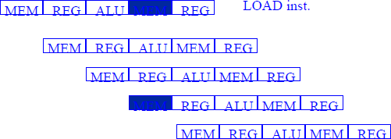
Structural Hazards and Stalls - Conflicts

Slide 36
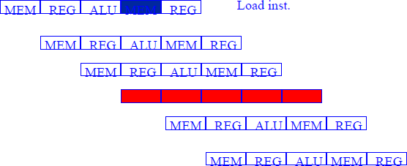
Structural Hazards and Stalls - Solution

Slide 37
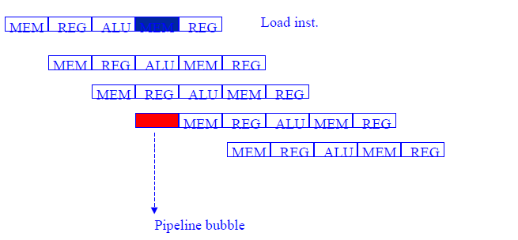
Structural Hazards and Stalls - Bubble

Slide 38
Data Hazard - Example
Consider the instruction sequence:
ADD R1,R2,R3 ; result is in R1
SUB R4,R5,R1
AND R6,R1,R7
OR R8,R1,R9
XOR R10,R1,R11
All instructions use R1 after the first instruction.

Slide 39
Data Hazard - Solution
Usually solved by data or register forwarding (bypassing or short - circuiting).
How? The data selected is not really used in ID but in the next stage: ALU.
Forwarding works as follows:
ALU result from EX/MEM buffer is always fed back to ALU input latches.
If the forwarding hardware detects that its source operand has a new value, the logic selects the newer result than the value read from the register file.

Slide 40
Data Hazard – Solution (cont’d)
The results need to be forwarded not only from the immediate previous instruction but also from any instruction that started up to three cycles before.
The result from EX/MEM (1 cycle before) and MEM/WB (2 cycles before) are forwarded to the both ALU inputs.
Writing into the register file is done in the first half of the cycle and read is done in the second half.(3 cycles before)

Slide 41
Data Hazard – Example
Example 1 :
add $s0, $t0, $t1
sub $t2, $s0, $t3
In the example, the second instruction is dependent on the result in $s0 of the first instruction:
if $s0 = -5 before add
$s0 = 8 after add
then the value 8 should be used in the second instruction sub.
Draw the multiple clock cycle pipeline diagram for the execution:

Slide 42
Data Hazard – Example(cont’d)
Execution Time CC1 CC2 CC3 CC4 CC5 CC6
order
add $s0, $t0, $t1 IF -----ID------EX------MEM----WB
value in $s0 -5 -5 -5 -5 -5/8 8
sub $t2, $s0, $t3 IF -----ID-------EX------MEM-----WB
In which clock cycle add writes to $s0? Clock 5
In which clock cycle sub reads $s0? Clock 3
For sub instruction, the value in $s0 has to be read in its ID stage (CC3).
However, the value in $s0 in CC3 is still -5 and not the correct value
8. We can only have the correct value in $s0 at the end of clock 5 (CC5).
The dependency goes from CC5 ---> CC3 (backward)

Slide 43
Data Hazard Stalls
All data hazards cannot be solved by forwarding:
LW R1,0(R2)
SUB R4,R1, R5
AND R6,R1,R7
OR R8,R1,R9
Unlike the previous example, data is available until a MEM/WB.
So subtract ALU cycle has to be stalled introducing a (vertical) bubble.

Slide 44
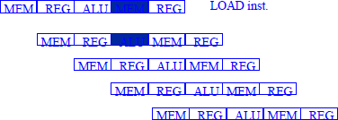
Data Hazards and Stalls

Slide 45
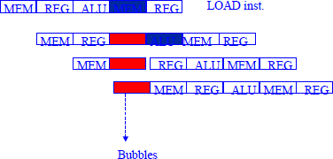
Data Hazards and Stalls

Slide 46
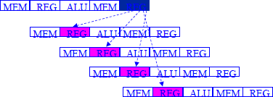
Data Hazards – Time Stage Diagram

Slide 47
Data Hazard Classification
RAW - Read After Write. Most common: solved by data forwarding.
WAW - Write After Write : Inst i (load) before inst j (add).
Both write to same register. But inst i does it before inst j. DLX avoids this by waiting for WB to write to registers. So no WAW hazard in DLX.
WAR - Write after Read: inst j tries to write a destination before it is read by I, so I incorrectly gets its value. This cannot happen in DLX since all inst read early (ID) but write late (WB).
But WAW happens in complex instruction sets that have auto- increment mode and require operands to be read late cycle experience WAW.

Slide 48
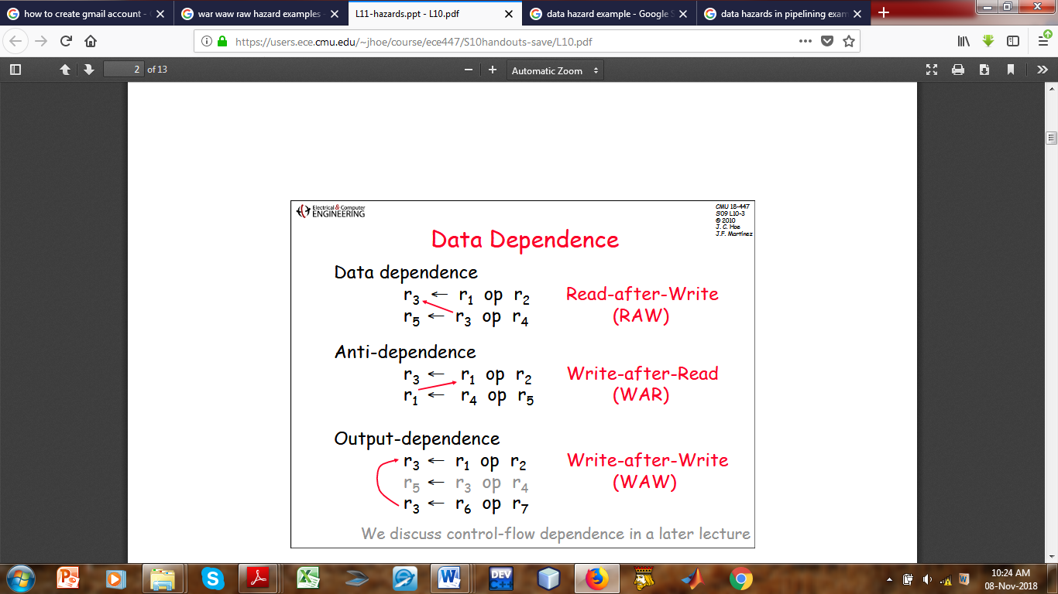
Data Hazard Classifications
  Describe each of the following categories of Data Hazards: RAW, WAR, WAW. Using (I – iii) below state which is RAW, WAR or WAW and indicate how each occurs using an arrow.
R3 ← R1 op R2 ii) R3 ← R1 op R2 iii) R3 ← R1 op R2
R5 ← R3 op R4 R1 ← R4 op R5 R3 ← R6 op R7

Slide 49
Example 1
Identify hazards in the following code:
I1: ADD R1, R2, R3
I2: SUB R4, R1, R5
I3: MUL R1, R6, R7
I4: DIV R8, R1, R9
Solution
Between I1 and I2
  I2 reads R1 after I1 writes R1.
  RAW hazard.
Between I1 and I3
  I3 writes R1 after I1 writes R1.
  WAW hazard.

Slide 50
Example 1
Between I3 and I4
  I4 reads R1 after I3 writes R1.
  RAW hazard.
Final Answer
I1 → I2 : RAW
I1 → I3 : WAW
I3 → I4 : RAW

Slide 51
Example 2
Given the instruction sequence:
I1: LOAD R1, 0(R2)
I2: ADD R3, R1, R4
I3: SUB R5, R6, R7
I4: MUL R8, R3, R9
Rearrange instructions to minimize stalls.
Solution
Original Sequence
LOAD → dependent ADD immediately
This creates a load-use hazard.

Slide 52
Example 2
Optimized Scheduling
Move independent instructions between dependent instructions.
I1: LOAD R1, 0(R2)
I3: SUB R5, R6, R7
I2: ADD R3, R1, R4
I4: MUL R8, R3, R9
Explanation
SUB instruction fills the delay slot and reduces stalling.
Final Answer
Optimized sequence:
LOAD – SUB – ADD - MUL

Slide 53
Effects of Pipeline Hazards
Data dependency between successive tasks: There may be dependencies between the instructions of two tasks used in the pipeline.
For example:
  One instruction cannot be started until the previous instruction returns the results, as both are interdependent.
  Another instance of data dependency will be when both instructions try to modify the same data object. These are called data hazards.

Slide 54
Effects of Pipeline Hazards
Resource Constraints: When resources are not available at the time of execution then delays are caused in pipelining.
For example:
If one common memory is used for both data and instructions and there is need to read/write and fetch the instruction at the same time, then only one can be carried out and the other has to wait.
Limited resource like execution unit, which may be busy at the required time.

Slide 55
Conclusion
Improving system performance is a major objective in processor design, and pipelining provides an effective solution for achieving this goal.
By dividing instruction execution into stages and allowing overlapping operations, pipelining increases processor throughput and makes better use of CPU resources.
Despite the challenges associated with hazards and synchronization, modern computer systems employ sophisticated hardware and software techniques to reduce pipeline delays and maintain efficient execution.

Slide 56
Conclusion
As processor technologies continue to evolve, pipelining remains a foundational concept in high-performance computing and advanced processor architecture.
Understanding pipelining enables students and system designers to appreciate how modern processors execute instructions rapidly and efficiently, making it an essential topic in Computer Architecture and Organization.

Slide 57
End of Unit

